Slide 1

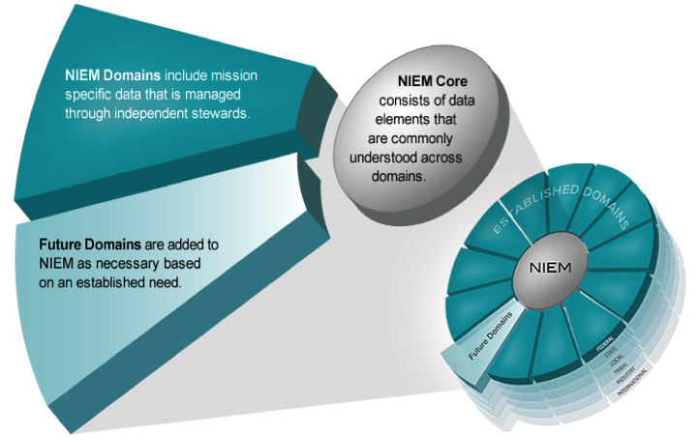
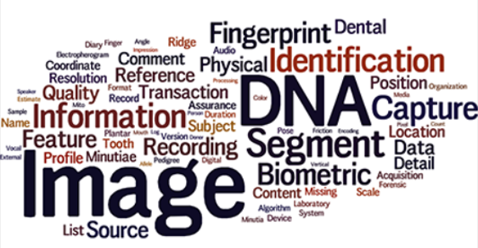


The NIEM MODEL
The BIOMETRICS DOMAIN
Membership & Benefits
The NIEM Biometrics domain was launched in July 2012 under the stewardship of the Office of Biometric Identity Management (OBIM) within the Department of Homeland Security (DHS) National Protection and Programs Directorate (NPPD).
The Biometrics domain operates under the oversight of its executive committee. The domain leverages current and emerging technology, lessons learned, and successes to enhance internal processes and operational effectiveness; improve external sharing and productivity; and support national information sharing programs.
Domain members can contribute to efforts in the Biometrics domain including formal training, domain related best practices, working group participation and collaborative review and creation of biometric standards, data exchanges, information models, and code management support.
Biometrics domain standing working groups drive solutions on technical and business issues and tiger teams attend to pressing needs within the COI. Technical assistance and support includes review of IEPDs); Biometrics-focused NIEM training for organizations and at conferences, and organizational system and policy alignment.
The NIEM model defines agreed-upon terms, definitions, relationships and formats—independent of how the information is stored in individual systems—for data being exchanged.
NIEM offers two ways to develop information exchanges—XML Schema, and through UML tooling. NIEM also offers the ability to transform XML schema to other data formats, such as JavaScript Object Notation (JSON) and Java objects.
Support Services
Analysis and assessment of existing IEPs and IEPDs
Development of new information exchanges and models and adaptation into the NIEM Biometric Domain
Standardization of organizations IEPDs
Gap analysis of existing information exchanges vs. national or int’l standards
Assessment of organizations information models for NIEM conformance
Harmonization guidance and facilitation
Information exchange technical issue tracking and best practice training
Assistance with development of organizations data & information models and data dictionary
Troubleshoot existing information exchange models and components
Created with input from the NIEM community, Movement provides a user friendly interface, smarter search results, and a streamlined way to build JSON Schema in support of exchanges. Movement is also open source so the community who inspired its creation can contribute to it.
Join the community
Open the doorway to contribution and benefits! Individuals and organizations within the Biometric Community of Interest are encouraged to join. For Membership inquiries, email:
NATIONAL INFORMATION EXCHANGE MODEL
OBIMFutureIdentitiesNIEM@ice.dhs.gov

Slide 2
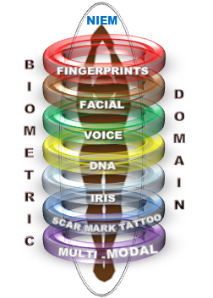


What is NIEM?
Domain steward support:
NIEM is a common vocabulary enabling efficient information exchange across diverse public and private organizations. NIEM can save time and money by providing repeatable processes and consistent, reusable data terms and definitions.
Charter and Governance
Common Data Dictionary
Component Mapping Template
Harmonization & Reconciliation
Collaboration Support
Implementation Guidance
Domain Vetting Process & Team Building
Outreach & Communication
Quality Assurance & Domain Stability
Requirements Management Process & Change Requests
IEPD Management
Data Standardization
Maintaining Synchronicity with related international data standardization initiatives
NATIONAL INFORMATION EXCHANGE MODEL
The Biometrics domain supports information sharing and promotes interoperability between mission-based organizations engaged in activities such as homeland security, national defense, border management, immigration benefits and global law enforcement through the joint development and alignment of XML Biometric Standards.
NIEM promotes…
Collaboration – Brings stakeholders together through reuse and strong community engagement
Consistency – Provides consistency through reusable schema, allowing many implementation options
Development – NIEM is flexible and extendable saving development time through agreed upon elements, relationships, and formats
Support – New users can leverage what already exists and engage with other NIEM members for assistance
John Boyd, DHS OBIM
Chief of NIEM Biometric Domain
Email: / phone:
Jennifer Stathakis (DOJ/FBI)
Co-Chair of NIEM BD
Email: / phone:
William Graves (DoD)
Co-Chair of NIEM BD
Email: / phone:
Diane Stephens (NIST)
NIST Ombudsman
Email: / phone:

